Slide 1
How I used OneNote to manage a medical crisis Steve Sawczyn Solutions Architect – Deque Systems Ailsa Leen Product Manager - Microsoft

Slide 2
Steve’s Story

Slide 3
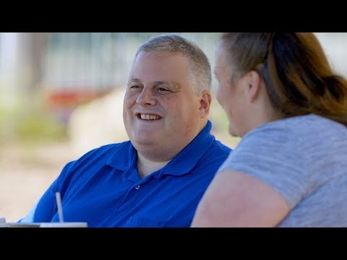
Video

Slide 4
Types of information We Take For Granted
Contact info for family,
Phone numbers for doctors and pharmacies,
Prescription information,
Account numbers and financial information…

Slide 5

Ordering meals and shopping for groceries can become a challenge.
Making grocery lists can be a challenge when focusing is difficult.
Ordering pizza or other food can seem daunting if research is needed to find phone numbers/web sites/menus.

Slide 6
Questions to Ask Yourself
What happens if I don’t have access to my phone or computer?
Does my important information exist in multiple places/on multiple devices?
If I am injured, can someone else access data that might be secured with a passcode, pin, or password?
What could no access to the Internet mean for me and my information?

Slide 7
More Questions to Ask Yourself
What about my spouse/partner/child/parent, do I have access to their personal info in an emergency?
Do I have a way to share information with others and have them share information with me?
Can a product update, software update, OS update lock me out of my own information?

Slide 8
How did OneNote Play a Critical Role for me and My Family
Information capture possible via computer, phone, web, Email, …
Ability to capture multiple formats such as text, images, web pages, audio recordings, …
Easy to share information with others and for others to share information with me.
Worked even when cell phone and Internet did not.

Slide 9
Practical Guide to OneNote

Slide 10
Introducing Microsoft OneNote
We’re free!
Available on iOS, Android, Mac
Windows 10 app (best Windows experience over OneNote 2016, 2013)
Organize your notes
Digital notebooks with sections and pages
All in one place, accessible from any device
Many types of digital content
Embedded online videos (YouTube, Vimeo etc)
Embedded files (Word, PowerPoint and more)
Audio and video recording
Digital ink
Tags

Slide 11
Some Updates
Accessibility Checker – UWP (Mac & iOS coming soon)
Additional rules – rolling out
Check an entire notebook in one go – coming soon
iPhone and iPad
Performance improvements
Custom rotor support – coming soon (navigation & custom actions)
Dictation
Coming soon – Online and UWP
Immersive Reader
Coming soon – Mac and iPad

Slide 12
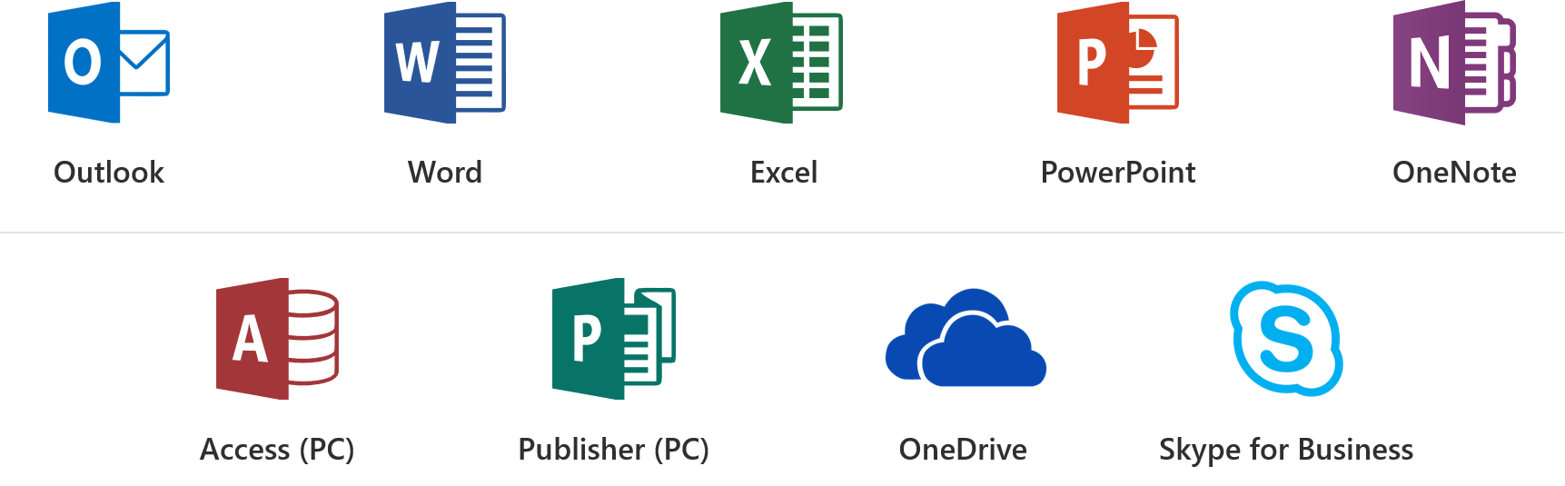
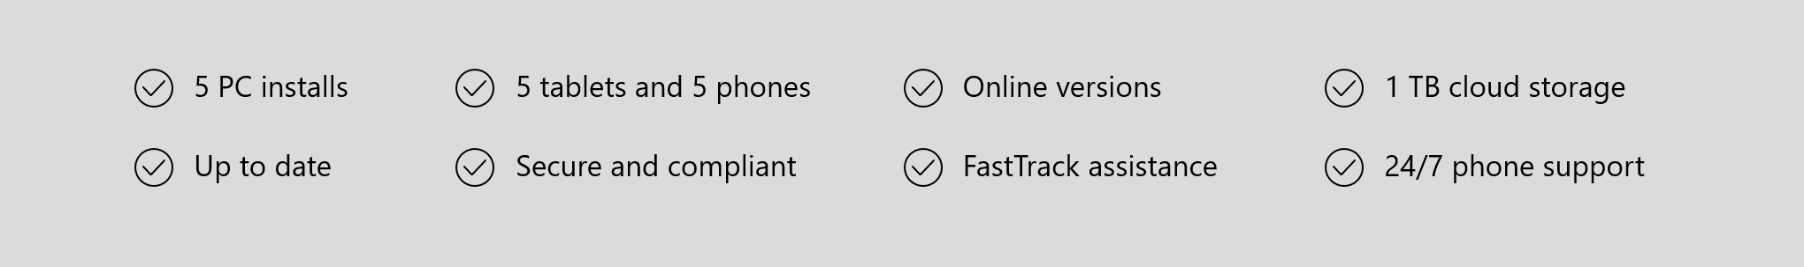
Office 365 ProPlus Overview

Slide 13
Office 365 Sessions at CSUN ATC in Seaport Ballroom H
3/21 11am: What’s New in Microsoft Office 365
3/22 8am: Strategies to Make your IT Applications More Accessible
3/22 11am: Create Inclusive Classrooms with Microsoft Education
3/22 1.20pm: Microsoft Reading, Writing and Learning Tools
3/22 3.20pm: Excel 101 Tips and Tricks
3/22 4.20pm: Easily create accessible content with Office 365
3/23 9am: Modernization of IT with SharePoint Accessibility
3/23 11am: Create Engaging and Accessible Presentations with PowerPoint and Sway
3/23 2.20pm: How I used Microsoft OneNote to Manage a Medical Crisis
3/23 4.20pm: Software Architecture in Office 365 for Exposing Accessible Content

Slide 14
OneNote Demo

Slide 15

Office Lens Demo
Office Lens is a great tool to convert analogue content to digital
Voice Guidance feature for capturing
Content is saved to OneNote and can be consumed through OCR or handwriting recognition

Slide 16
Steve’s Ideas for Improving OneNote
Integration with Cortana and Bing for background search queries,
Integration with additional Microsoft apps such as To-Do, Outlook, Edge …
Simultaneous and synchronized audio/text capture in a single note.

Slide 17
Presenter Contact Info
Steve Sawczyn
Email: Steve@Sawczyn.com
Twitter: @A11YForAll
LinkedIn: https://www.linkedin.com/in/SteveSawczyn
Mobile: (207) 458-8270
Ailsa Leen:
Email: ailsalee@microsoft.com
Twitter: @missaleeneous
OneNote accessibility documentation:
https://aka.ms/onenoteaccessibility

Slide 18
We want to hear from you.
Connect with us in person today or anytime through our support and feedback channels.
Disability Answer Desk for phone/chat/ASL Help: Aka.ms/AccessibilitySupport
User voice Forum for Accessibility Feedback: Aka.ms/AccessibilityFeedback
Notes:
Holding slide during presentation Q&A

